Slide 1
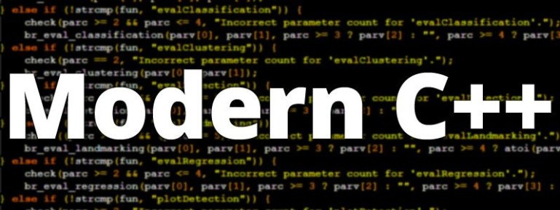
ADVAnce C++

Slide 2
MODERN C++
Introduction To std::array Class
std::array V/s C-style array
Declaring And Initializing
Member Functions

Slide 3
The std::array Class
The simplest standard container class is std::array which behaves just like a built-in ("C-style") array.
They are wrappers over C-style static arrays.
In order to use std::array class , we must include the header file <array>

Slide 4
std::array v/s C-Style array
The class std::array provides a rich set of functionality as compared to C-style arrays.
To understand the benefits of std::array class over C-style arrays , try answering the following questions:
Can you compare 2 C-style arrays using == operator ?
Does a C-style array knows its size ?
What happens when you pass a C-style array to a function ?
Can you swap 2 C-style arrays without writing your own logic ?
Can you sort a C-style array without writing your own logic ?
Can a C-style array prevent boundary overflow ?

Slide 5
std::array v/s C-Style array
The answers to all the questions in the previous slide are either No or unknown .
Now let us answer the same questions on std::array .
Can you compare 2 std::array using == operator ?
Yes , since == operator has been overloaded on std::array
Does a std::array knows its size ?
Yes , by calling its size() member function
What happens when you pass a std::array to a function ?
It’s passed as pass by value
Can you swap 2 std::array without writing your own logic ?
Yes , by calling the member function swap()
Can you sort an std::array without writing your own logic ?
Yes , by calling the function sort() of the header file <algorithm>
Can a std::array prevent boundary overflow?
Yes , it gives an exception called out_of_range

Slide 6
Declaring an std::array
In order to use std::array, we need to include a header file called <array> :
#include <array>
The declaration of std::array is as follows:
array<datatype,array_size> obj_name;
Example
array<int, 5> arr;
Here 'arr' is an object of the class std::array containing an array of type int and length 5.

Slide 7
Point to remember
Data type used while creating an std::array object an be any primitive or non primitive type
But size must ONLY BE an integer constant.

Slide 8
initializing an std::array
Like C-style arrays, we can initialize an std::array by simply assigning it values at the time of declaration.
Example:
array<int, 5> arr = {10, 20, 30, 40, 50};
//called initializer list
array<int, 5> arr {10, 20, 30, 40, 50};
// called as list initialization
array<int, 5> arr; arr= {10, 20, 30, 40, 50};

Slide 9
initializing an std::array
Like C-style arrays, we can initialize an std::array with lesser values but not with more number of values than size.
Example:
array<int, 5> arr= { 10, 20, 30, 40, 50 };
// okay
array<int, 5> arr= { 10, 20, 30 };
// okay, elements 3 and 4 are set to zero!
array<int, 5> arr= { 10, 20, 30, 40, 50,60 };
// not allowed, too many elements in initializer list!

Slide 10
Point to remember
Unlike C-style arrays, with std::array we can not omit the array length when providing an initializer:
Example
array<int, > arr { 10, 20,30,40,50 };
// illegal, array length must be provided
array<int> arr { 10, 20,30,40,50 };
// illegal, array length must be provided

Slide 11
Special case for c++ 17
However, since C++17, it is allowed to omit the type and size.
But there are 3 points to remember :
Both type and size have to be omitted together, but not one or the other
The array must be explicitly initialized.
Values must be of same type

Slide 12
Special case for c++ 17
Example:
array arr { 10,20,30,40,50};
// The type is deduced to std::array<int, 5>
array arr { 9.7, 7.31,3.4 };
// The type is deduced to std::array<double, 2>

Slide 13
Accessing individual value
We can access individual elements of a std::array in 2 ways:
Using [ ] operator
Using the member function at( )
Example:
array<int, 5> arr = { 10, 20, 30, 40, 50 };
cout << arr[2] << endl;
cout<<arr.at(2)<<endl;
Output:
30
30

Slide 14
An important point !
Question?
How [ ] and at( ) are different?
Answer
The method at( ) performs bound checking and will throw out_of_range exception if the index is beyond the length of the std::array while no such exception occurs in subscript operator

Slide 15
An important point !
Guess the output ?
array<int, 5> arr = { 10, 20, 30, 40, 50 };
cout << arr.at(6) << endl;
cout<<“Hello”;
Output:
out_of_range exception
The code is throwing exception since we are passing index 6 which out of the bounds. Also “Hello” will not be displayed

Slide 16
An important point !
Guess the output ?
array<int, 5> arr = { 10, 20, 30, 40, 50 };
cout << arr[6] << endl;
cout<<“Hello”;
Output:
0
Hello
This is garbage data and can be anything . The point to understand here is that no exception is occurring and “Hello” gets printed

